Slide 1
Year 2
Place Value
To know how to use a number line to 100 (1)

Slide 2
Summary
Key Vocabulary
Diagnostic Question
Learning Objective
Starter – Complete the number line (increasing in 1s)
Let’s Learn
Follow Me – Complete the number line (increasing in tens)
Your Turn (1) – Complete the number line (increasing in tens)
Follow Me – Which number is being pointed to
Your Turn (2) – Which number is being pointed to
Follow Me – Is the Mathling right
Your Turn (3) – Draw arrows on the number line and identify the mistakes
Let’s Reflect
Support Slides – Based on counting in tens

Slide 3
Key Vocabulary
number line | interval
division

Slide 4
Which number is the arrow pointing to?
0
100
8
80
90
70
Notes:
Assessment point for the lesson – ask the pupils to vote for the answer they think is correct.
A – The pupil has counted in ones, not in tens.
B – Correct answer
C – The pupil has miscounted, they may have counted starting with 10 where the number line is marked with 0.
D – The pupil has miscounted.

Slide 5
To use a number line to 100 (1)

Slide 6
Starter
Which numbers are missing from the number line?
0
1
2
3
4
5
6
7
8
9
10
Answers
Notes:
Concrete resources – A number line
Key Questions – How do you know which numbers are missing from the number line? What is the number line increasing in? How does this help you find the missing number? Which number is at the start of the number line?
Misconceptions/ Common Errors – Pupils may not remember that the number before 1 is 0.
Further Practice – Give pupils a number line section that goes beyond 10 with missing numbers.

Slide 7
Let’s Learn
Number lines are very useful in maths. We can use them to count, help us add and more.
What do you notice about this number line?
0
10
20
30
40
50
60
70
80
90
100
Notes:
Pupils may notice lots of different things about the number line. This number line is increasing in tens. Pupils have covered counting in tens before.
Concrete resources – Number line or number tracks
Key Questions – What do you notice about the number line? We call the lines divisions, what are the division going up in?
Further Practice – Give pupils a number line with fewer divisions but still increasing in tens, what do they notice about this number line (pupils may thing number lines always have 11 divisions/ 10 intervals).

Slide 8
Follow Me
Complete these number lines.
0
10
20
30
40
50
60
70
80
90
100
40
50
60
70
80
90
Answers
Notes:
Concrete resources – Number line, items bundled into tens (Base 10, sticks of 10, 10s number shapes)
Key Questions – Which numbers are missing? How do you know? Can you show the missing numbers using concrete resources? What is different about the second number line? Does the size of the intervals change the missing numbers?
Misconceptions/ Common Errors – Pupils may think the size of the intervals change the value of each interval.

Slide 9
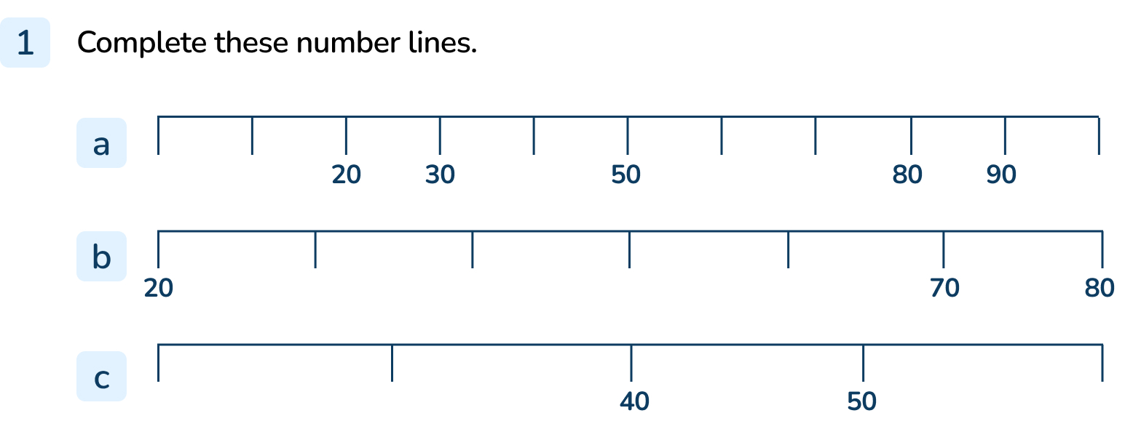
Your Turn
Notes:
0, 10, 40, 60, 70, 100
30, 40, 50, 60
20, 30, 60

Slide 10
Follow Me
What number is the arrow pointing to?
It’s best to label the number line to check you’re right.
0
10
20
30
40
50
60
70
80
90
100
Answers
Notes:
Concrete resources – Number line, items bundled into tens (if pupils need to count in tens)
Key Questions – Which numbers are missing? How does writing all the missing numbers help? When we count in tens, what number do we say after 0?
Misconceptions/ Common Errors – Pupils may start counting from 10 (even though it is labelled as 0).
Further Practice – Draw another arrow – which number is it pointing to?

Slide 11
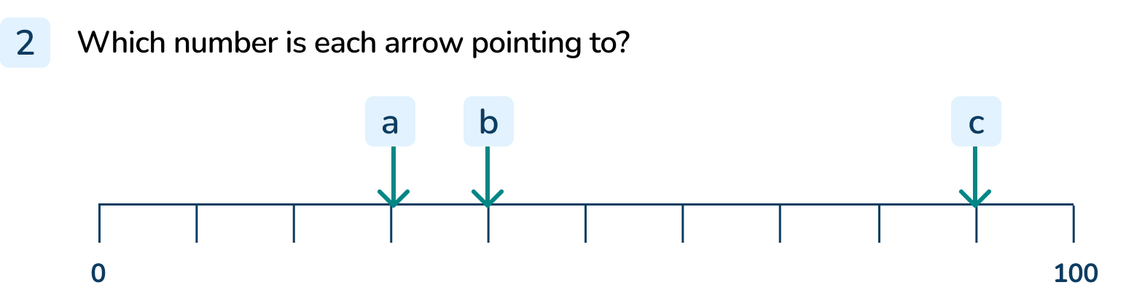
Your Turn
Notes:
30
40
90

Slide 12

Follow Me
The Mathling says it has used an arrow to show the number 50 on the number line.
Do you agree?
0
10
20
30
40
50
60
70
80
90
100
The Mathling is wrong. When we label the number line, we can see the Mathling miscounted.
Answers
Notes:
Concrete resources – Number line
Key Questions – Which number do you think the arrow is pointing to? Is the Mathling right? What mistake do you think the Mathling has made?
Misconceptions/ Common Errors – The pupil may agree with the Mathling.
Extension – The midpoint is the middle of the number line. What is the midpoint? How can you use this to show that the Mathling is wrong?

Slide 13
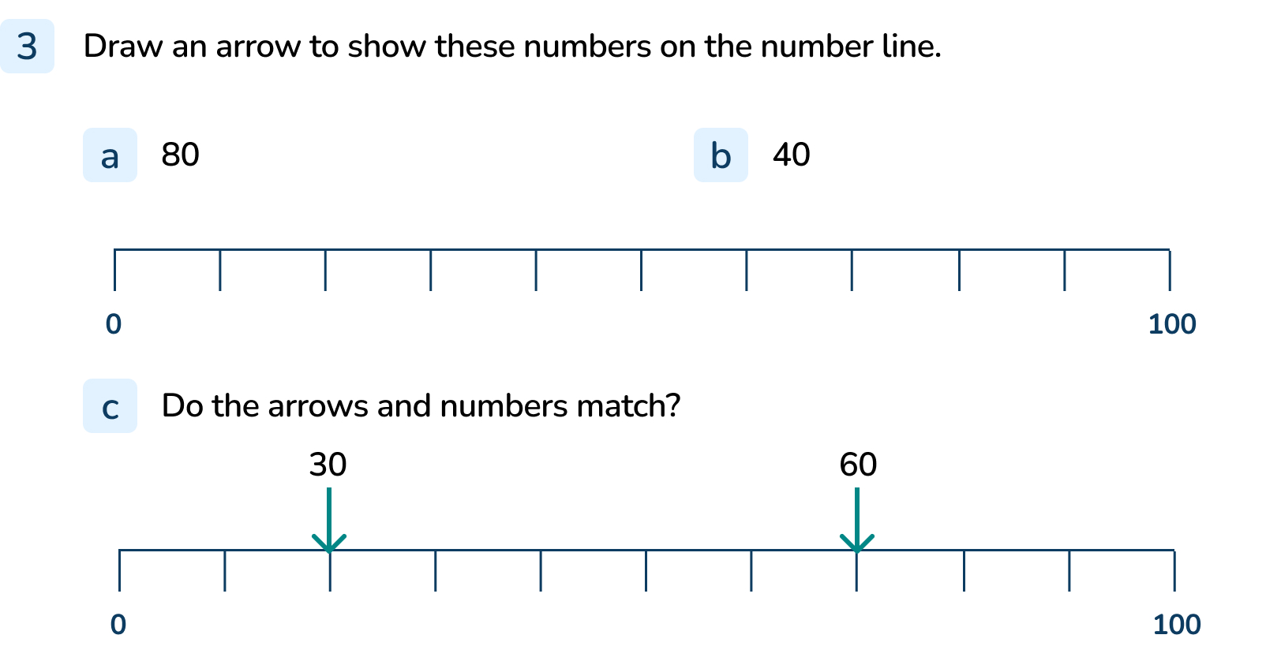
Your Turn
Notes:
a and b) Arrows should accurately show 80 and 40.
c) Incorrect, this shows 20
d) Incorrect, this shows 70

Slide 14
Let’s Reflect
Explain how to find which number the arrow is pointing to.
0
100
Notes:
Encourage pupils to explain the process they would use, not the answer.
Concrete resources – Number line
Key Questions – What can you do first to help you find which number the arrow is pointing to? What is the number line increasing in? 0 is marked so do you start counting her from 10?
Misconceptions/ Common Errors – Pupils may focus on the answer, not the process.

Slide 15
The following slides are based on:
Counting in tens

Slide 16
What is similar and different about these number tracks?
Notes:
How and when to use these slides – Use these slides to ensure that pupils know how to count in tens as they need to be confident with counting in tens for the main part of this lesson.
Use this slide to identify the connection between counting in ones and counting in tens.
Concrete resources – Base 10
Key Questions – What do the number tracks show? What is the same about the number lines? What is different? Can you explain the pattern?
Misconceptions/ Common Errors – Pupils may say that counting in tens is the same as counting in ones but ‘adding a zero’. This is inaccurate and leads to misconceptions later.
Further Practice – Continue the pattern using Base 10.

Slide 17

How many sticks are there in each group?
40
70
30
Answers
Notes:
Concrete resources – Sticks in tens
Key Questions – How many sticks are in each group? How many groups of ten are there/ Do you need to count each stick individually? Does it matter if the bundles of sticks are spread out?
Misconceptions/ Common Errors – Pupils may count each stick individually rather than counting in tens.
Further Practice – Can you make the bundles using real sticks.

