Slide 1
Year 2
Place Value
To know how to partition numbers in different ways

Slide 2
Summary
Key Vocabulary and Sentence Stems
Diagnostic Question
Learning Objective
Starter – Continue a sequence
Let’s Learn
Follow Me – Using Base 10 to partition in different ways
Your Turn (1) – Using Base 10 to partition in different ways
Follow Me – Using part-whole models to partition in different ways
Your Turn (2) – Using part-whole models to partition in different ways
Follow Me – Is the Mathling correct?
Your Turn (3) – Is the Mathling correct?
Let’s Reflect
Support Slides – Based on partitioning numbers

Slide 3
Key Vocabulary
numeral | numbers
part-whole | tens
ones | partitioning
add/ addition | equals
number sentence
Sentence Stems
There is/ are (digit) ten(s) and (digit) one(s). The number is (number).
There are 3 tens and 1 one. The number is 31.
(digit) ten(s) + (digit) one(s) = (number)
3 tens + 1 one = 31

Slide 4
Which of these is not a way to partition 36?
30 and 6
20 and 16
10 and 26
3 and 6
Notes:
Assessment point for the lesson – ask the pupils to vote for the answer they think is correct.
A – The pupil has not understood the question and has identified a way to partition 36.
B – The pupil has not understood the question and has identified a way to partition 36.
C – The pupil has not understood the question and has identified a way to partition 36.
D – Correct answer

Slide 5
To partition numbers in different ways

Slide 6
Starter
Fill in the missing numbers.
1 ten and 4 ones = 14
2 tens and _____ ones = 24
_____ tens and 4 ones = 34
_____ tens and _____ ones = _____
_____ tens and _____ ones = _____
What would the next number in the pattern be?
4
3
4
4
44
5
4
54
6 tens and 4 ones = 64
Answers
Notes:
Concrete resources – Base 10, place value counters etc to support
Key Questions – What would the next number be in the pattern? What is the pattern? Which number does not change? Why not? How could we write these as number sentences? Does that change the pattern? What would come next after 9 tens and 4 ones?
Misconceptions/ Common Errors – Counting in 10s. The ones do not change just the tens.

Slide 7
Let’s Learn
We can make numbers in lots of different ways.
Let’s look at 42.
We can partition 42 into 40 and 2.
We can also partition it into 30 and 12.
How else could we partition 42?
20 and 22
10 and 32
Answers
Notes:
Note that pupils may partition into 40 + 1 etc. this is accurate but encourage them to partition into whole tens so they can see the pattern.
Concrete resources – Base 10 or place value counters that pupils could move around to make different numbers.
Key Questions – What do you notice about how we’re grouping the Base 10? How can we make sure we have found all possible options? What do you notice about the numbers? Have you found a different way to partition the number? What do these partitioned numbers all have in common? (They all represent 42)
Misconceptions/ Common Errors – Pupils not working systematically so missing options.

Slide 8
Follow Me
Use the Base 10 to create different ways to make 76.
Find 5 possibilities.
70 and 6
60 and 16
50 and 26
40 and 36
30 and 46
20 and 56
10 and 66
Answers
Notes:
Concrete resources – Base 10
Key Questions – How many tens are there? How many ones? Is there a system we could use to find all the different ways to make 76? Check with your partner, did you find a different way to them?
Further Practice – Different number to make combinations

Slide 9
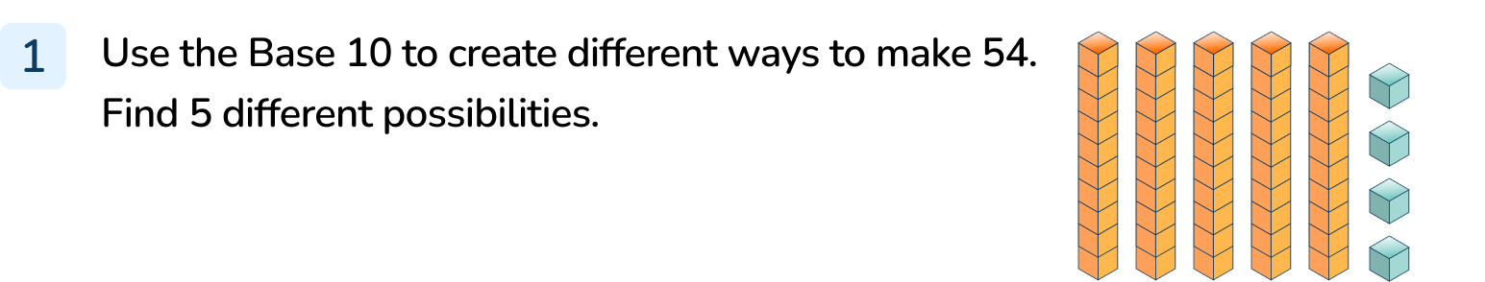
Your Turn
Notes:
50 and 4
40 and 14
30 and 24
20 and 34
10 and 44

Slide 10
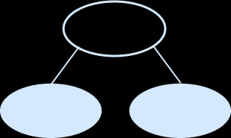
Follow Me
Here is a part whole model.
Can you find 3 different ways to complete it by partitioning?
One has been done for you.
53
50
3
53
53
53
40
13
30
23
20
33
10 and 43 is another possibility.
Answers
Notes:
Concrete resources – Range of concrete materials - base 10, number shapes, place value cards
Key Questions – Which part do we know? How can we use the whole and part to work out the missing part? Does the top number stay the same even though we are partitioning it in different ways? How many tens are there? How many ones? Does it matter which numbers you put in which circle? What must you always make sure they add up to? What do you notice about the number in one of the circles?
Misconceptions/ Common Errors – Pupils do not always remember to write the tens correctly if the number is a multiple of 10. Using concrete material to partition the top number in different ways will help them record the numbers accurately.
Further Practice – Different number at the top (see independent practice)
Extension – Could you extend your part-whole model further? Partition the numbers at the bottom?

Slide 11
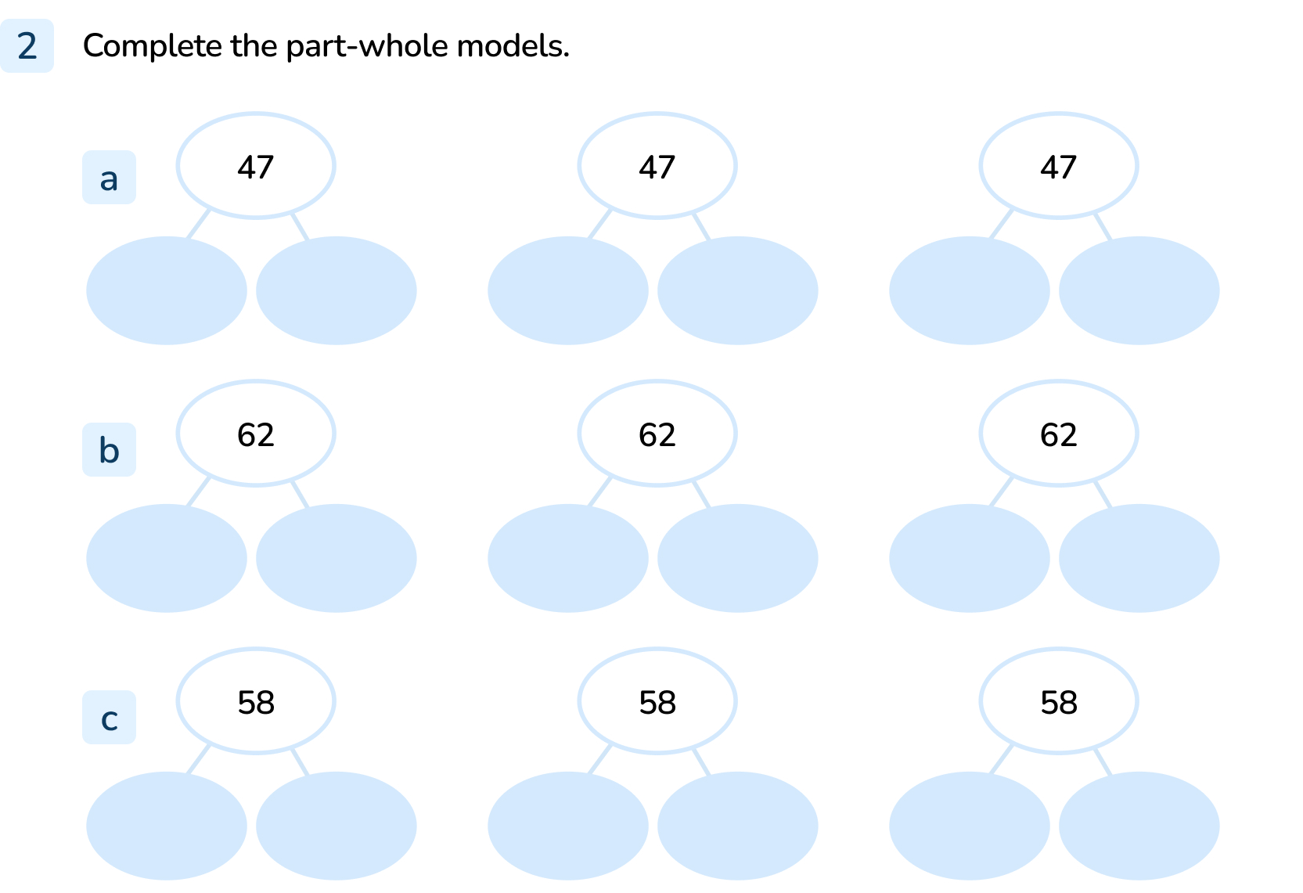
Your Turn
Notes:
40 and 7, 30 and 17, 20 and 27, 10 and 37
60 and 2, 50 and 12, 40 and 22, 30 and 32, 20 and 42, 10 and 52
50 and 8, 40 and 18, 30 and 28, 20 and 38, 10 and 48

Slide 12



Follow Me
The Mathling is using concrete resources to partition a number.
Is the Mathling correct?
Convince me.
This shows 47 can be partitioned into 40 and 7.
The Mathling is not correct because there are 4 tens in one group and 2 tens and 5 ones in the other group.
This is 40 and 25 which equals 65.
The whole is 65, the parts are 40 and 25.
Answers
Notes:
Concrete resources – Place value counter, base 10
Key Questions – What numbers do the concrete resources show? Does it matter that they are different resources? Can we use the resources to help us work out whether the Mathling is correct? How many tens are there? How many ones are there? How many altogether? What mistake has the Mathling made when counting the resources?
Misconceptions/ Common Errors – Counting the resources as 1 and not recognising that there are tens too.
Further Practice – Make different number sentences using concrete resources and working out answer.
Extension – How else could we make 65?

Slide 13
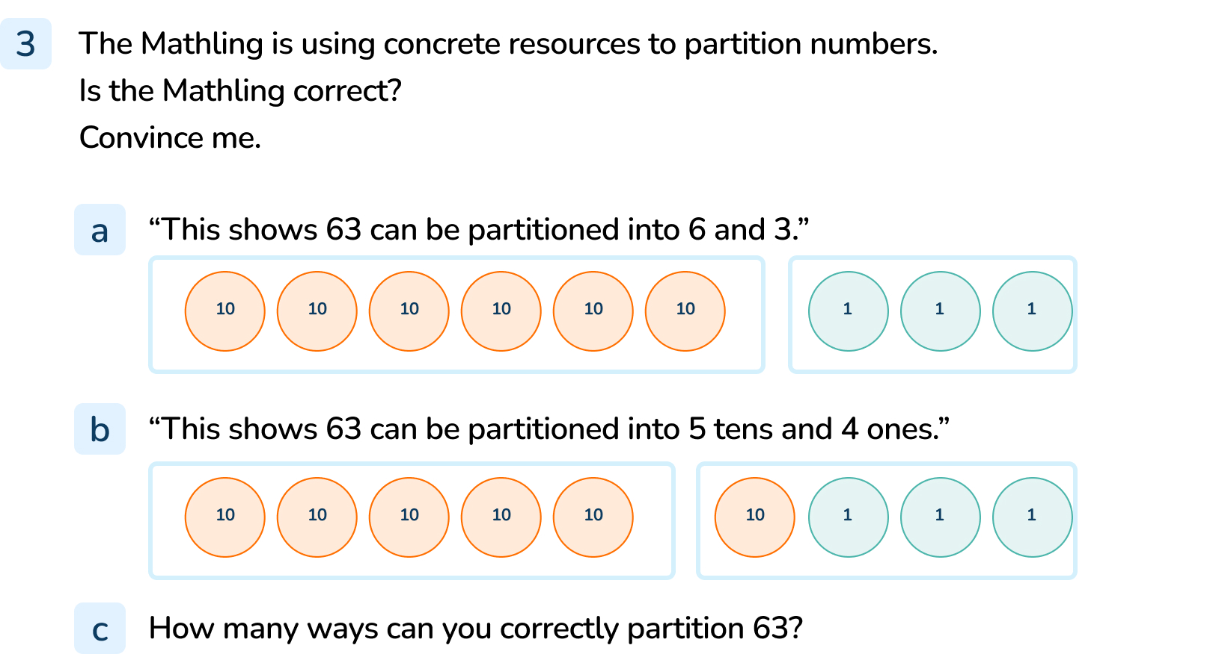
Your Turn
Notes:
Incorrect. This shows that 63 can be partitioned into 6 tens and 3 ones or 60 and 3.
Incorrect. This shows that 63 can be partitioned into 5 tens and 13 ones.
Answers will vary.

Slide 14
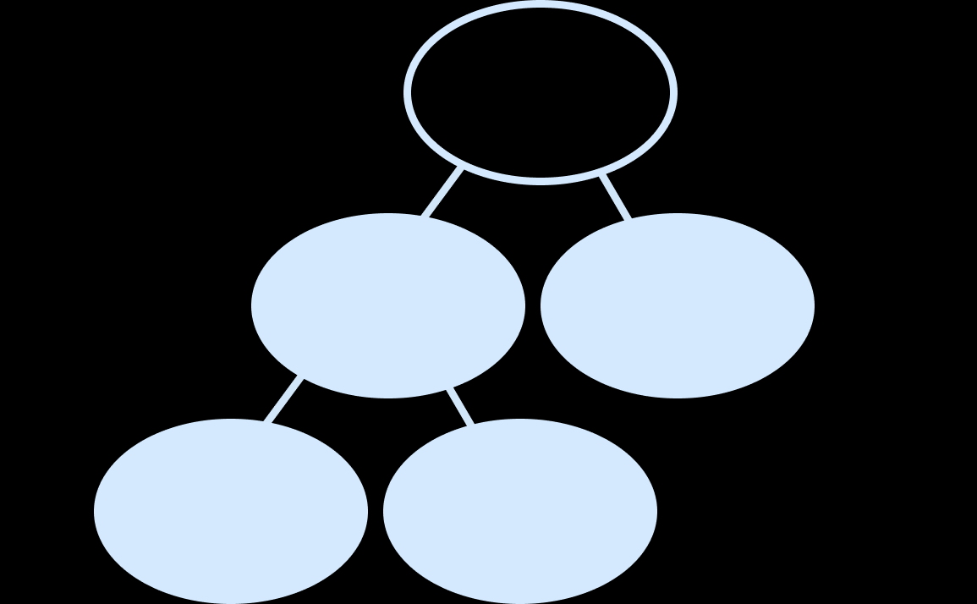
Let’s Reflect
Complete the extended part-whole model.
93
60
33
40
20
Answers
Notes:
Concrete resources – Range of concrete materials e.g. base 10, number shapes, place value cards etc
Key Questions – What information have we got to help work out the missing parts? Would there be more than one answer to the missing parts? Why not? Which part should we work out first? Why? What concrete resources can we use to help us?
Misconceptions/ Common Errors – Pupils may work out a way of partitioning 93 without looking at the extension and therefore the part-whole model will not be completed properly.
Further Practice – Different extended part-whole model (see independent practice)
Extension – Create own extended models and give to a partner to see if they can complete them.

Slide 15
The following slides are based on:
Partitioning numbers

Slide 16
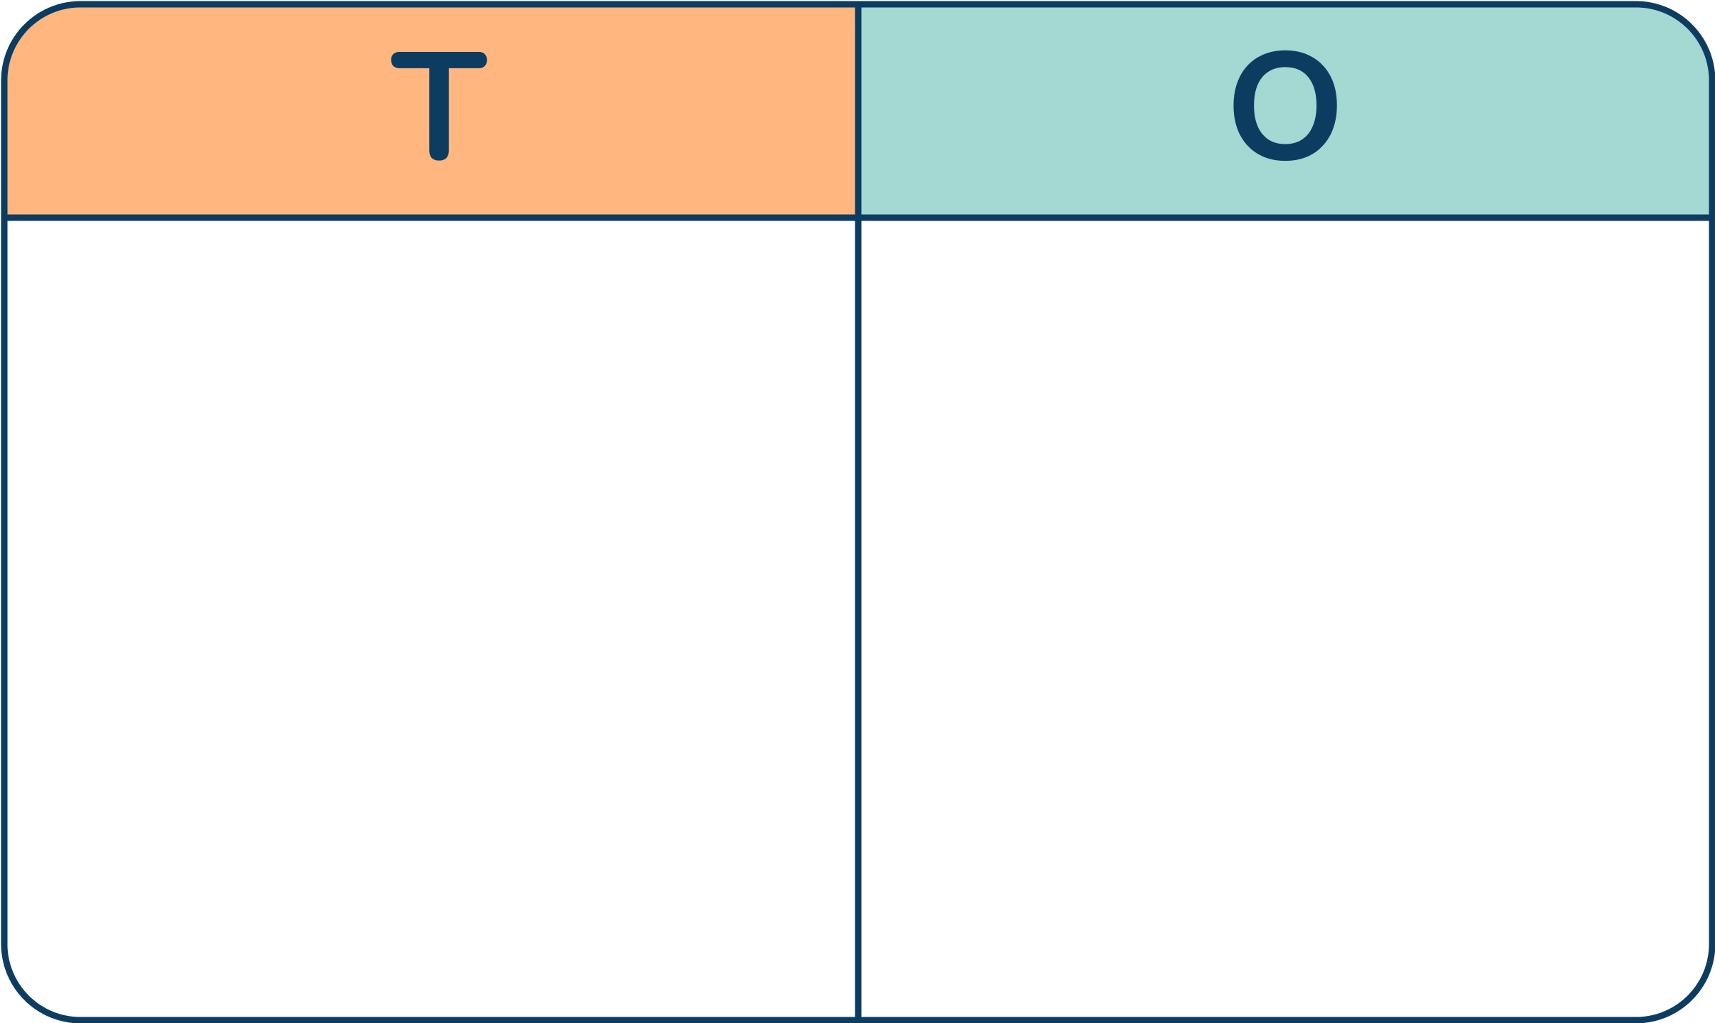
True or false?
False
3 tens and 6 ones = 36
= 35 True or false?
= 68 True or false?
True
Answers
Notes:
How and when to use these slides –If pupils struggle with partitioning of numbers. To build their understanding that ten ones can be grouped into one ten. They make need to practice grouping equipment into tens themselves before introducing ready made tens or place value counters.
Concrete resources – base 10, place value charts
Key Questions – How many tens are there? How many ones are there? I have ___ tens and ___ ones. What number does that make? Can we count the base 10 to check the number? What happens when you count the tens block? Do you count 1 or 10?
Misconceptions/ Common Errors – Pupils may count all the base 10 in ones and not understanding that the tens block should be counted as a 10 not 1.
Further Practice – Different numbers inside the place value chart and pupils write down the number as well as the tens and ones it is partitioned into. E.g. 42 = 4 tens and 2 ones.

Slide 17
Complete these part-whole models.
5
4
2___
___5
Answers
Notes:
How and when to use these slides – Consolidate how to partition numbers using part-whole model and the representation of the tens and one place.
Concrete resources – Place value counters, part-whole models
Key Questions – How many tens are there? How many ones are there? I have ___ tens and ___ ones. What number does that make? How do I know if there is a ten or a one missing in the part-whole number? How do you represent 20 in place value counters? How do you represent 5? Are they different counters? Why?
Misconceptions/ Common Errors – Understanding that the ten place value counter has a value of 10 and should not be counted as a 1.
Further Practice – Different numbers to partition in the part-whole model using place value counters.

Slide 18
Complete the sentences.
24 has _____ tens and _____ ones.
_____ has 5 tens and 8 ones.
41has _____ tens and _____ ones.
_____ has 8 tens and 9 ones.
2
4
58
4
1
89
Answers
Notes:
How and when to use these slides – If pupils struggle with moving away from concrete materials and recognising how to partition numbers. It is important that pupils understand how a number is made up of tens and ones, e.g. 36 = 3 tens and 6 ones.
Concrete resources – Base 10 to support
Key Questions – How many tens are there? How many ones are there? Can you show me what ___ tens and ___ ones looks like in base 10? What number is ___ tens and ___ones? Which digit is the tens? Which digit is the ones?
Misconceptions/ Common Errors – Pupils may struggle to write a number when given the tens and ones. Some may write the whole multiple of ten e.g. 24 has 20 tens and 4 ones.
Further Practice – More 2 digit numbers to partition into tens and ones

