Slide 1
Year 1
Place Value (within 10)
To know how to count 1 more

Slide 2
Summary
Key Vocabulary and Sentence Stems
Diagnostic Question
Learning Objective
Starter – One more in a line
Let’s Learn
Follow Me – One more from a single given number
Your Turn (1) – One more from a single given number
Follow Me – Completing the sentence stem
Your Turn (2) – Completing the sentence stem
Follow Me – Complete the grid
Your Turn (3) – Practical activity
Let’s Reflect
Support Slides – Based on 1 more (EYFS)

Slide 3
Key Vocabulary
more | greater
one more | most
Sentence Stems
The number after a number is one more.
One more than (number) is (number).
OR (number) is one more than (number).
One more than 5 is 6.
6 is one more than 5.

Slide 4
The Mathling has two bananas.
It is given 1 more.
How many does it have now?
2
1
3
4
Notes:
Assessment point for the lesson – ask the pupils to vote for the answer they think is correct.
A – The pupil has identified how many bananas there are now.
B – The pupil has found 1 less.
C – Correct answer.
D – The pupil has counted each banana twice.

Slide 5
To count 1 more

Slide 6
Starter
The Mathlings are in a line.
1 more arrives.
How many are there now?
There are 4 Mathlings now. There will be 5 when one more arrives.
Answers
Notes:
Concrete resources – Counters, number tracks
Key Questions – How many Mathlings are in the line? How do we find one more? What direction will we move on the number tracks?

Slide 7
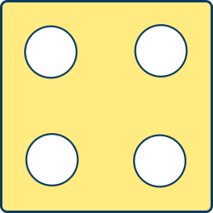
Let’s Learn
Complete the pattern.
1 more
1 more
1 more
Answers
Notes:
Concrete resources – Number tracks, die, counters etc to represent the numbers given
Key Questions – How can we find 1 more? What does 1 more mean? When I use a number tracks to count 1 more, which direction do I move?
Misconceptions/ Common Errors – Starting from a different number
Further Practice – Roll a dice and count one more on the number tracks.

Slide 8
Follow Me
Find one more than each number.
1 more
8
1 more
9
six
1 more
seven
Answers
Notes:
Concrete resources – Number tracks, word bank
Key Questions – How can counting help us find 1 more? What does 1 more mean? How do we find 1 more?
Misconceptions/ Common Errors – Misunderstanding numerical and written representations of the number.

Slide 9
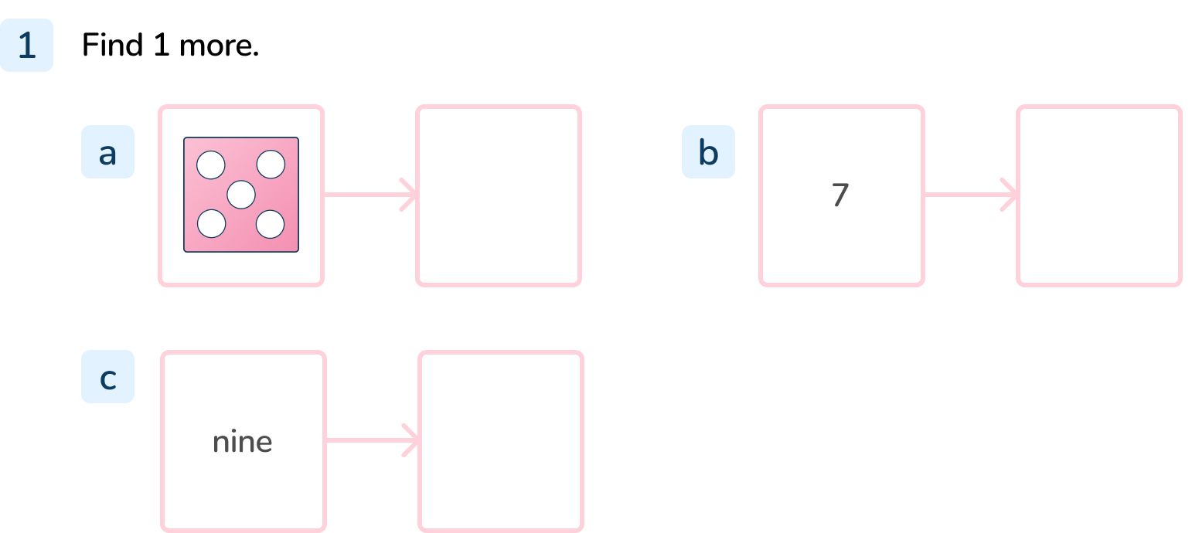
Your Turn
Notes:
Dice showing 6 (or the number 6)
8
ten

Slide 10
Follow Me
Complete the sentence stems.
1 more than _____ is _____.
_____ is 1 more than _____.
1 more than _____ is _____.
_____ is 1 more than _____.
3
4
1 | 2 | 3 | 4 | 5 | 6 | 7 | 8 | 9 | 10
one | two | three | four | five | six | seven | eight | nine | ten
4
3
8
9
1 | 2 | 3 | 4 | 5 | 6 | 7 | 8 | 9 | 10
one | two | three | four | five | six | seven | eight | nine | ten
9
8
Answers
Notes:
Concrete resources – Number tracks, counters
Key Questions – Which number will be one more? How do you know? Will the number be more than the number the counter is on?
Misconceptions/ Common Errors – Errors when reciting stem sentence. Confusion over the wording of the second sentence stem.
Further Practice – Give different numbers to find 1 more for.
Extension – Writing own stem sentence for a partner.

Slide 11
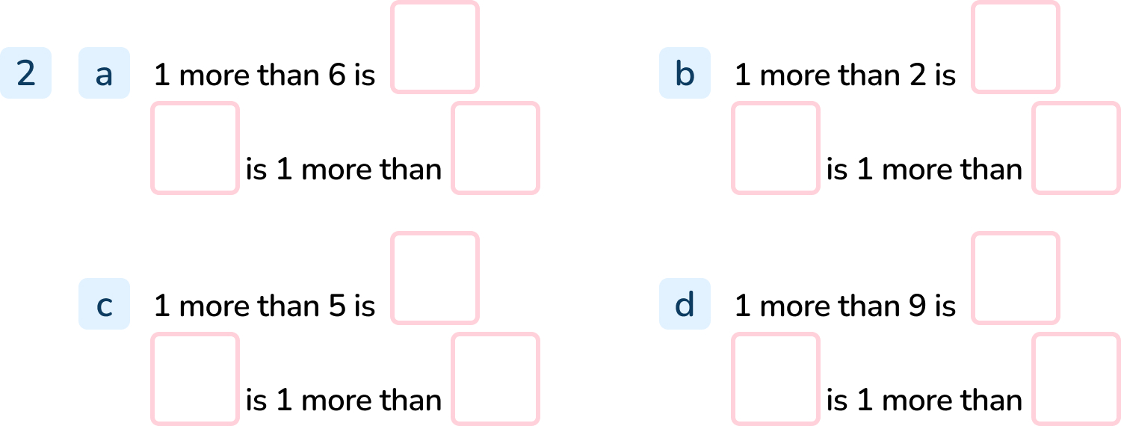
Your Turn
Notes:
7, 7, 6,
3, 3, 2,
6, 6, 5,
10, 10, 9

Slide 12
Follow Me
Complete the grid.
Number in numerals 2 | Number in words | Tens Frame
Stem Sentence 1 more than _____ is _____. _____ is 1 more than _____.
two
2
3
3
2
Answers
Notes:
Concrete resources – Number tracks, word mat for numbers as words
Key Questions – How can we show 1 more? Do we need to count from 1 or 0 every time to find 1 more? How can you use the tens frame to help you find 1 more?

Slide 13
Your Turn
Notes:
Answers will vary depending on the numbers chosen.

Slide 14
Let’s Reflect
I am one year older than my brother.
My brother is one year older than my sister.
My sister is 5 years old.
The Mathling says,
How old is the Mathling?
The Mathling is 7 years old.
Its brother is 6 years old.
Answers
Notes:
Concrete resources – Any resources used in this lesson (number tracks, number tracks, tens frame, dice)
Key Questions – How could you solve this? How old is its sister? How old is its brother? How old is the Mathling?
Misconceptions/ Common Errors – Identifying the astronaut as 6 years old (counting on one) or 4 years old (counting one back).

Slide 15
The following slides are based on: 1 more

Slide 16
Add 1 more banana to the line.
Notes:
How and when to use these slides – Use these slides to ensure pupils understand the concept of 1 more meaning adding one to a sequence.
Concrete resources – Toy bananas or counters (etc) to represent the bananas
Key Questions – What do you need to do to ‘add 1 more’? What do you notice about how many bananas there are (more or less)?
Misconceptions/ Common Errors – Pupils not understanding the language used.

Slide 17
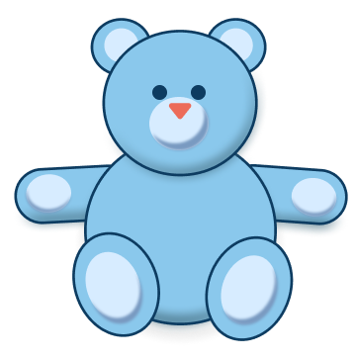
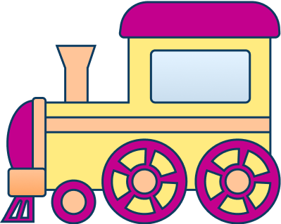
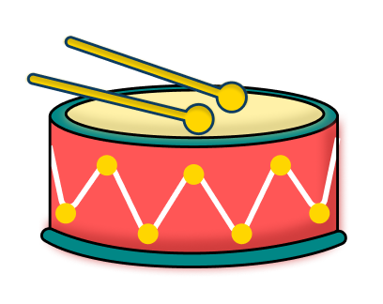
Add one more toy to the line.
Notes:
Concrete resources – Toys in a line
Key Questions – How do you ’add 1 more’? Do I have more toys when I add 1 more?
Misconceptions/ Common Errors – Pupils thinking that the ‘1 more’ needs to follow a pattern.

