Slide 1
Year 4
Place Value
To know how to find 1, 10, 100 and 1,000 more or less than a number

Slide 2
Summary
Key Vocabulary and Sentence Stems
Diagnostic Question
Learning Objective
Starter – Complete the number line
Let’s Learn
Follow Me – More or less with a place value chart
Your Turn (1) – More or less with a place value chart
Follow Me – Spot the mistake
Your Turn (2) – More or less crossing boundaries
Follow Me – Missing parts
Your Turn (3) – True or false
Let’s Reflect
Support Slides – Based on using number lines to count on and back

Slide 3
Key Vocabulary
more than | less than
Sentence Stems
When finding one thousand more/ less than a positive number, the ones and tens columns do not change.
One/ ten / one hundred more/ less than (number) is (number).
OR (number) is one/ ten / one hundred more/ less than (number).
Ten more than 15 is 25. OR 25 is ten more than 15.
When finding ten more/ less, the ones column does not change. (For a positive number only.)

Slide 4
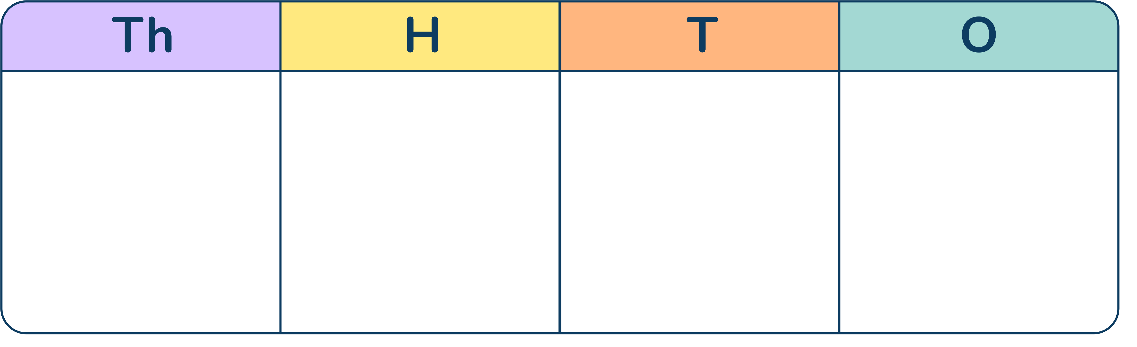




What is 100 less than this number?
552
4,153
5,253
5,053
Notes:
Assessment point for the lesson – ask the pupils to vote for the answer they think is correct.
A – The pupil has not included the place holder.
B – The pupil has found 1,000 less than the number.
C – The pupil has found 100 more than the number.
D – Correct answer.

Slide 5
To find 1, 10, 100 and 1,000 more or less than a number

Slide 6
Starter
Is there more than one way to complete this number line?
Explain one way to complete it.
540
Notes:
Pupils answers will vary. Pupils could increase in 1s, 10s, 100s, 1,000s or they may pick 2s, 5s etc.
Concrete resources – Number line
Key Questions – How have you completed the number line? What do you notice? How is your number line different to another number line? How is it similar? How else could you have completed the number line?
Misconceptions/ Common Errors – Pupils may use ones only and not understand that there are multiple ways to complete the number line.

Slide 7
Let’s Learn
We can use place value counters and place value charts to find 1, 10, 100 and 1,000 more or less than a number.
We can remove 1 one counter to find 1 less.
We can add 1 thousands counter to find 1,000 more.
Notes:
Use this slide to discuss finding 1, 10, 100 or 1,000 more or less than a number. Use the given number to explain how to do this. Note that in this slide, we do not focus on crossing boundaries.
Concrete resources – Place value counters and chart
Key Questions – What number is shown? How do you find 1/ 10/ 100/ 1,000 more or less than the number? What happens to the columns? How do they change? Which columns will not change?
Further Practice – Find 100 less or 10 more etc

Slide 8

Follow Me
The Mathling wants to find 10 more than this number.
What is 10 more than this number?
The number is 3,162. 10 more than 3,162 is 3,172.
What is 10 less than the given number?
What is 1,000 more and less than the given number?
3,152
4,162 and 2,162
Answers
Notes:
Encourage pupils to think carefully about how to increase a number by 10 (more than just saying ”add a tens counter”).
Concrete resources – Place value counters, place value chart
Key Questions – How many tens are there now? When you find more, does the number get larger or smaller? How do you know? Which column(s) will change? How do you know?
Misconceptions/ Common Errors – Pupils may explain that one counter needs to be added. Encourage them to be detailed and specific in their explanations.

Slide 9
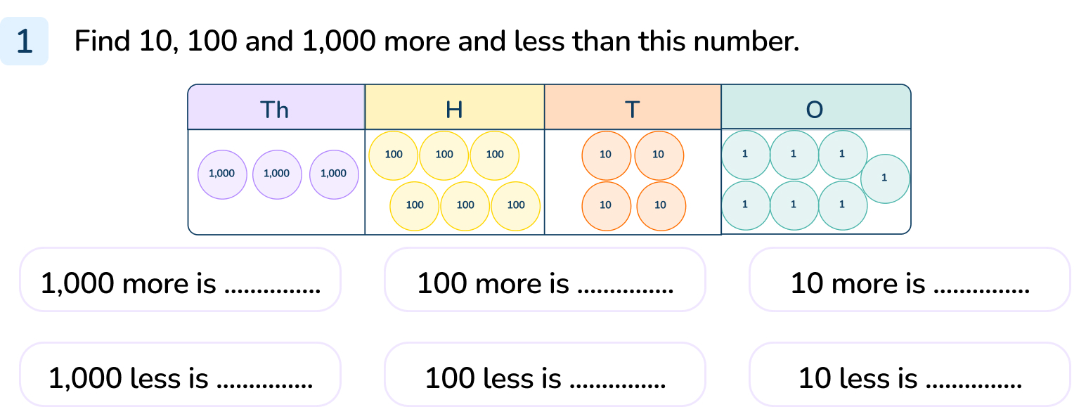
Your Turn
Notes:
The number is 3,647
1,000 more is 4,647
1,000 less is 2,647
100 more is 3,747
100 less is 3,547
10 more is 3,657
10 less is 3,637

Slide 10
Follow Me
Spot the mistake.
100 more than 1,921 is 1,1021
100 more
When we find 100 more than 1,921 we need to regroup. There are 10 hundred counters in the hundreds column. 10 hundred counters are the same as 1 thousand counter.
100 more than 1,921 is 2,021.
Answers
Notes:
Concrete resources – Place value counters and place value chart
Key Questions – How many 100s make 1 thousand? (This can be repeated for the other columns.) How many hundreds are left in this column? (If pupils struggle, using concrete resources will help them. Use Base 10 if pupils are struggling so they can see the equivalent values of 10 hundreds and 1 thousand.)

Slide 11
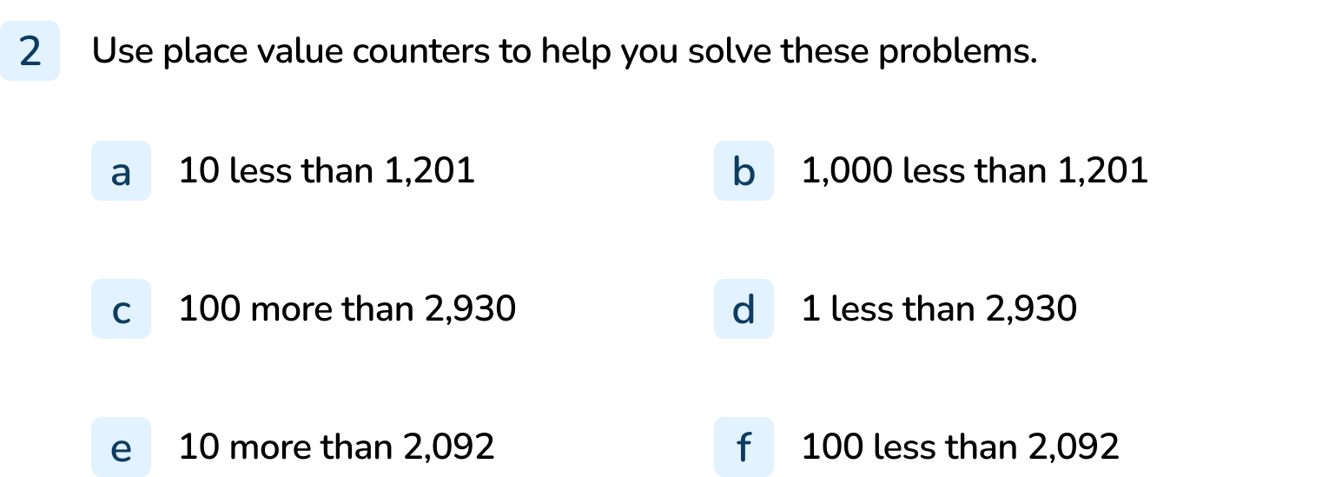
Your Turn
Notes:
1,191
201
3,030
2,929
2,102
1,992

Slide 12
Follow Me
Complete the calculations.
How do you know what is missing?
5,080
– 100
4,980
7,280
– 1,000
6,280
7,200
+ 10
7,210
Answers
Notes:
Concrete resources – Place value counters, base 10
Key Questions – How can you complete these calculations using the information given? Can you use concrete resources to help you?
Misconceptions/ Common Errors – Pupils may not know to complete the inverse operation for the first question.
Extension – Can you find a different method to solve the calculations (e.g. if the pupil used abstract addition, can they use concrete or pictorial representations?)?

Slide 13
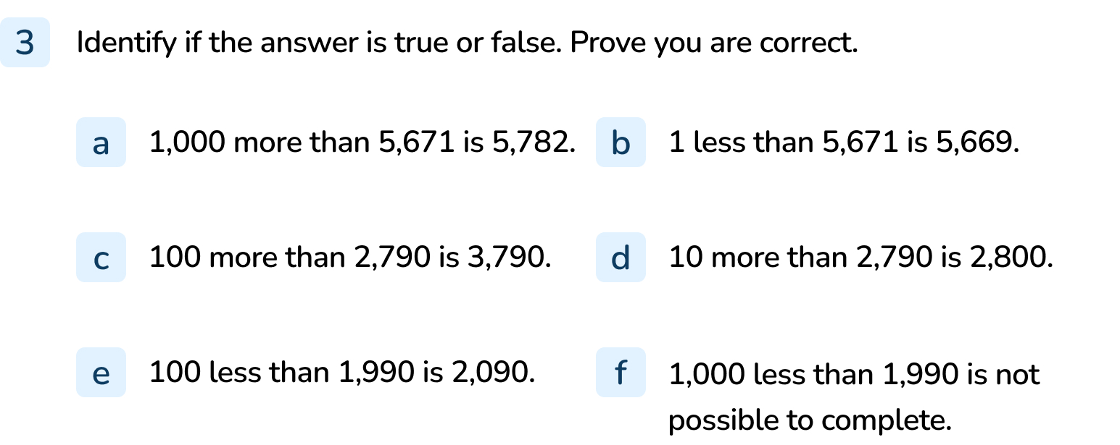
Your Turn
Notes:
False – the hundreds, tens and ones have been increased by 1.
False – 2 has been subtracted, not 1.
False – this is 1,000 more.
True
False – this would be 100 more.
False - the answer should be 990.

Slide 14
Let’s Reflect
When I find 10 less than my 4-digit number, the tens and hundreds columns change.
What number could I be thinking of?
Notes:
There are lots of different possible answers. The tens digit should be 0.
Concrete resources – Place value counters or Base 10
Key Questions – Which number would fit my statement? What does the digit in the tens column need to be? Why can it not be another number?

Slide 15
The following slides are based on:
Using number lines to count on and back

Slide 16
Which numbers are missing on the number line?
248
249
250
251
252
253
254
255
256
257
258
Answers
Notes:
How and when to use these slides – Use these slides to help pupils approach finding more or less than a number a familiar way. Encourage counting in multiples together to help identify the pattern that forms.
Concrete resources – Number line
Key Questions – What are the numbers increasing/ decreasing by? What happens when you count 1 more than 249? How do the digits in the number change? Why is zero important in this number?
Misconceptions/ Common Errors – Pupils may attempt to miss 250 (249 to 251).

Slide 17
Which numbers are missing on the number line?
420
430
440
450
460
470
480
490
500
510
520
Answers
Notes:
Concrete resources – Number line
Key Questions – What is this number line increasing in? How do you know? When will the hundreds and tens column change? Why?
Misconceptions/ Common Errors – Pupils may not identify that the number line is increasing in 10 as only two consecutive multiples of 10 are given.
Further Practice – Repeat with a different number line.

