Slide 1
Year 6
Place Value
To know how to compare and order integers

Slide 2
Summary
Key Vocabulary and Sentence Stems
Diagnostic Question
Learning Objective
Starter – Compare numbers to 1,000,000
Let’s Learn
Follow Me – Complete the place value chart to compare
Your Turn (1) – Compare numbers
Follow Me – Order the numbers
Your Turn (2) – Order the numbers
Follow Me – Which numbers could be missing?
Your Turn (3) – Ordering numbers using given information
Let’s Reflect
Support Slides – Based on comparing and ordering numbers to 1,000,000

Slide 3
Key Vocabulary
integer | ten million
greater than | less than
ascending | descending
Sentence Stems
To compare two numbers, start with the largest place value digit.
Compare digits with the same place value.

Slide 4
Which symbol should be used to complete the statement?
1,557,414
1,557,441
<
>
=
Can’t compare them.
Notes:
Assessment point for the lesson – ask the pupils to vote for the answer they think is correct.
A – Correct answer
B – The pupil has not understood the difference between < and >. Alternatively, they have not identified the difference in the tens and ones columns.
C – The pupil has not understood the meaning of the equals symbol. Alternatively, they have noted that the digits are the same and has assumed the numbers are the same
D – The pupil does not understand how to compare numbers.

Slide 5
To compare and order integers

Slide 6
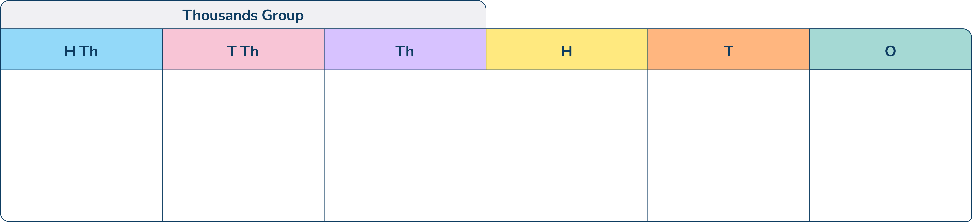

Starter
Compare the numbers using <, > or =.
<
567,097
=
500,000 + 60,000 + 7,000 + 90 + 7
Four hundred and twenty thousand, five hundred and thirty-four
<
Four hundred and two thousand, five hundred and thirty-four
Answers
Notes:
Concrete resources – Place value chart and counters
Key Questions – What number does this represent? How do you know? What do the symbols <, > and = mean?

Slide 7
Let’s Learn
Explain how you would compare these two numbers.
8,488,488 884,884
Explain which symbol you would use and why.
Notes:
Pupils need to understand that the first number is a 7-digit number and the second number is a 6-digit number. As the first number is 7-digits, it must be the larger of the two numbers. Use place value counters or counters and a place value chart to check this understanding.
Concrete resources – Place Value chart and counters
Key Questions – How many digits are in each column? Why is this important? Where do you start when comparing numbers? Is this always the same?
Misconceptions/ Common Errors – Pupils may try to compare 8,000,000 with 800,000 as they believe they compare the largest value digit in each number.
Further Practice – Give pupils pairs of numbers with the same or different number of digits to compare.
Extension – Explain the common error that could happen here.

Slide 8
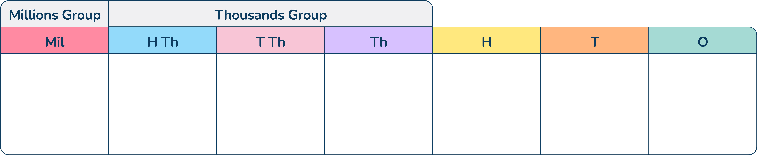

Follow Me
How could you complete this place value chart to make the statement true?
Is there more than one way?
The number given is 1,232,302. The number in the empty place value grid must be less than this, for example, 1,200,000 or 299,000 or 1.
Answers
Notes:
Concrete resources – Place value chart and counters
Key Questions – What does the > mean? How does this help you complete the statement? Compare your number with some else’s number, are they both correct? How do you know?
Further Practice – Change the number or the symbol. For pupils who are struggling, start with = to build their confidence.
Extension – Place parameters on the task, for example, using the same number of counters or having 3 counters in the hundreds column.

Slide 9
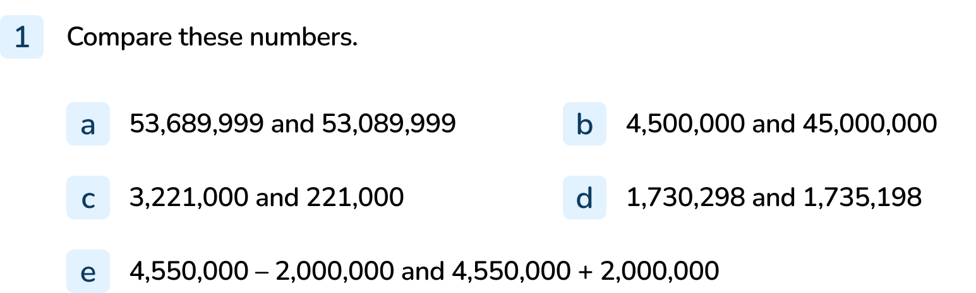
Your Turn
Notes:
>
<
>
<
<
Extension: Do you need to calculate the answer to e to compare the numbers? Pupils do not need to complete the calculations. Explanations should identify that the start number is the same and one number sentence involves addition while the other involves subtraction. Pupils should understand that the addition calculation will provide the largest answer.

Slide 10
Follow Me
Put these in ascending order.
Explain how you decided on the order.
2,451,113
2,452,000
2,341,042
Ascending order means smallest to largest.
2,341,042 2,451,113 2,452,000
Answers
Notes:
Concrete resources – Place value chart and counters
Key Questions – What does ‘ascending’ mean? All the numbers start with 2,000,000 so how can you compare the numbers? Is this always the case?
Misconceptions/ Common Errors – Pupils may not understand ‘ascending’ and ‘descending’

Slide 11
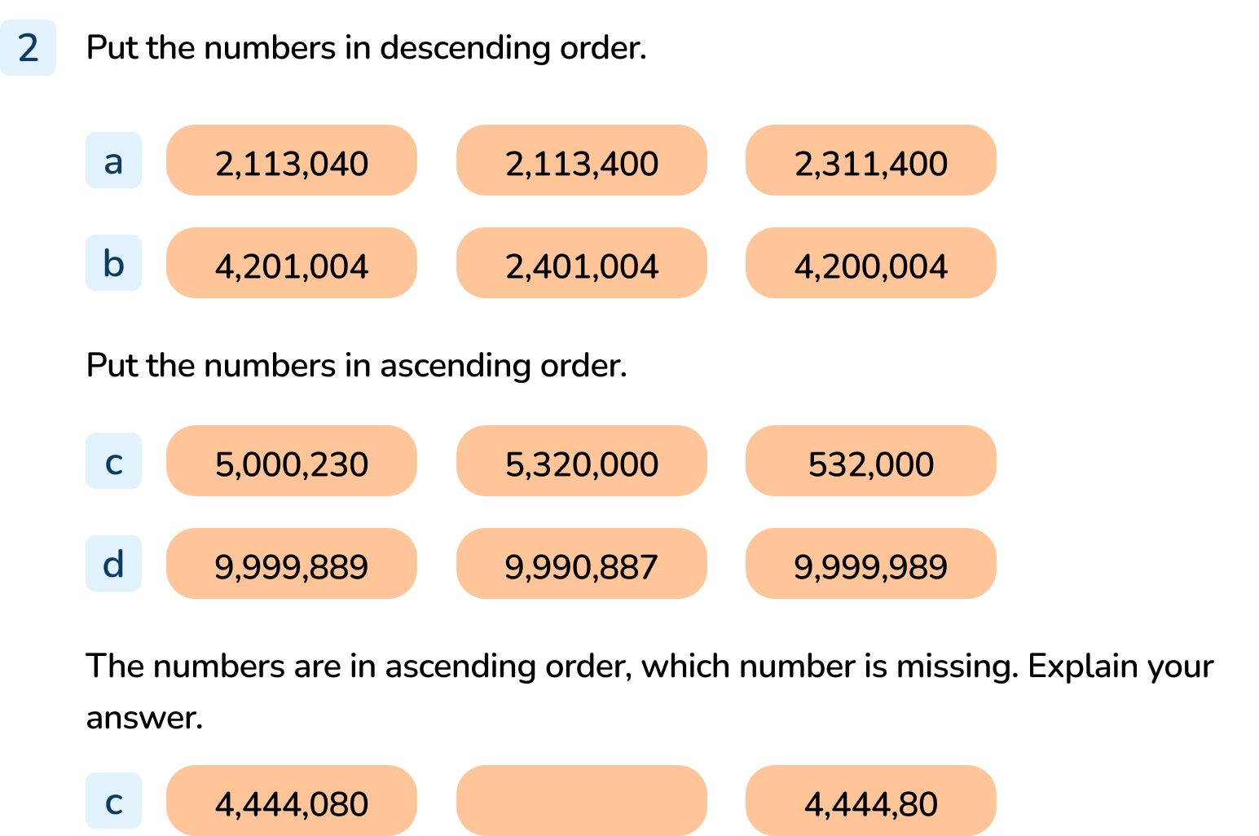
Your Turn
Notes:
2,311,400 then 2,113,400 then 2,113,040
4,201,004 then 4,200,004 then 2,401,004
532,000 then 5,000,230 then 5,320,000
9,990,887 then 9,999,889 then 9,999,989
Any number between 4,444,081 and 4,444,799. Explanations should demonstrate an understanding of how to order numbers. For example, The missing number could be 4,444,500 as this is smaller than 4,444,800 and larger than 4,444,080.

Slide 12

Follow Me
The Mathling has written six 7-digit numbers on cards and put them in ascending order.
Its largest number is 1,432,000
Its smallest number is 1,234,000
It says it has used the same digits in each number.
What could the missing numbers be?
1,234,000
1,432,000
His missing numbers could be any number greater than 1,234,000 and less than 1,432,000 using the digits 1,2,3,4,0,0,0.
For example, 1,243,000; 1,240,300; 1,240,030; 1,240,003; 1,324,000; 1,400,032 and so on
Answers
Notes:
Concrete resources – Place value chart and counters
Key Questions – If the digits are the same, list the digits you can use. What do you notice about the value of the digits as you move them? Could 2,431,000 be one of the numbers? Why/ why not?
Misconceptions/ Common Errors – Pupils may not identify all the important information and identify numbers that do not fit the criteria (e.g. they do not have the given digits or are larger/ smaller than the given numbers).

Slide 13
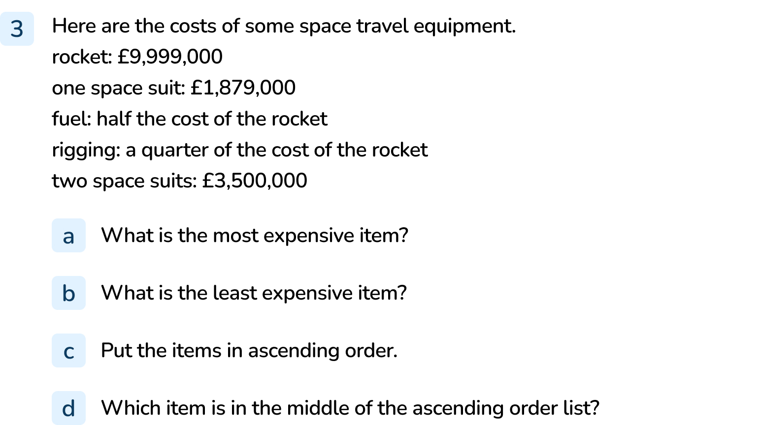
Your Turn
Notes:
Rocket (£9,999,000)
One Space Suit (£1,879,000)
One Space Suit (£1,879,000), rigging (£2,499,750), two space suits (£3,500,000), fuel (£4,999,500), rocket (£9,999,000)
Two space suits

Slide 14
Let’s Reflect
Explain how to compare the numbers and put them in descending order.
1,230,000
123,000
1,203,000
Notes:
Concrete resources – Place value chart and counters
Key Questions – What do you notice about the numbers? What do you need to do first when comparing them? Explain your process. Prompt questions to draw out further understand e.g. can you explain what you mean? How do you know? Why?

Slide 15
The following slides are based on:
Comparing and ordering numbers to 1,000,000

Slide 16






Explain how to compare these numbers.
<
>
170,000
5,120
100,000
7,512
Answers
Notes:
How and when to use – Use these slides when pupils are struggling to understand how to compare digits up to one million.
Concrete resources – Place value chart and counters
Key Questions – What number do the counters/ part-whole models represents? How do you know? What happens if some of the digits are the same (discuss why place value is important)?
Misconceptions/ Common Errors – Starting in the wrong place, continuing to compare digits after they have found the larger value digit in the same column.

Slide 17

What is the largest number you can make from 6 counters?
What is the smallest number you can make from 6 counters?
The largest number is 6,000,000.
The smallest number is 6.
Answers
Notes:
How and when to use – Use these slides when pupils are struggling to understand how to compare digits up to one million.
Concrete resources – Place value chart and counters
Key Questions – What do the columns mean? What does it mean when a column is empty? When do you use zero?
Further Practice – Place parameters e.g. the ones column must have two counters only.

Slide 18



Put these numbers in ascending order (smallest to largest).
B then A then C.
Answers
Notes:
How and when to use – Use these slides when pupils are struggling to understand how to compare digits up to one million.
Concrete resources – Place value chart and counters
Key Questions – What does each number in the place value chart represent? Two numbers have the same in the millions column, why what do you do to compare them?
Further Practice – Move counters to make new numbers to compare.

