Slide 1
Year 1
Place Value (within 10)
To understand how to compare groups by matching one-to-one

Slide 2
Summary
Key Vocabulary and Sentence Stems
Diagnostic Question
Learning Objective
Starter – 1 less
Let’s Learn
Follow Me – One-to-one correspondence with more in one group
Your Turn (1) – One-to-one correspondence with more in one group
Follow Me – Matching groups with equal numbers
Your Turn (2) – Matching groups with equal numbers
Follow Me – Drawing to make enough in both groups
Your Turn (3) – Drawing to make enough in both groups
Let’s Reflect
Support Slides – Based on comparing quantities of identical objects

Slide 3
Key Vocabulary
number | numeral
equal | greater than
fewer than
Sentence Stems
There are (number/items). There are (number/items). There are (number/ item) altogether.
There are 3 blue blocks. There are 2 yellow blocks. There are 5 blocks altogether.

Slide 4




The Mathlings are having a party.
They each get a cake.
How many cakes are there?
3
6
1
4
Notes:
Assessment point for the lesson – ask the pupils to vote for the answer they think is correct.
A – Correct answer.
B – The pupil has counted how many Mathlings and cakes there are.
C – The pupil has identified that each Mathling gets one cake.
D – The pupil has counted one more than the number of cakes.

Slide 5
To compare groups by matching one-to-one

Slide 6

Starter
These cupcakes are on a table. One of them gets eaten.
There is then 1 less cupcake.
How many cupcakes are there now?
There were 7 cupcakes. 1 was eaten. Then there were 6 cupcakes.
Answers
Notes:
Concrete resources – Toy food or concrete resources to represent the cupcakes
Key Questions – How many cupcakes were on the table? If one was eaten, how many are left?
Misconceptions/ Common Errors – Pupils thinking that the cupcakes shown are how many are left.

Slide 7
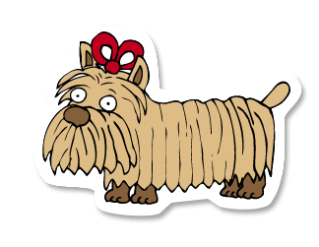

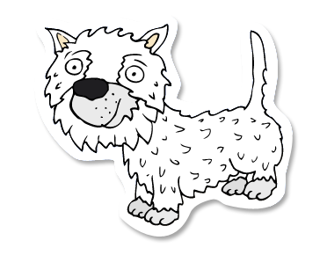
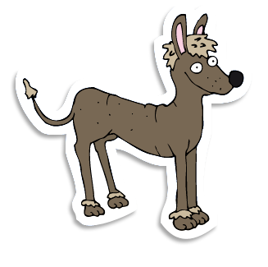


Let’s Learn
All the dogs want a bone.
Draw one bone for each dog.
Notes:
Each dog should have a bone, there will be 6 bones.
Concrete resources – Counters
Key Questions – How many are there? How many will bones will you need to draw?
Misconceptions/ Common Errors – Miss counting not counting when drawing
Further Practice – Matching physical images to items
Extension – 2 items e.g the dogs would like a ball and a bone

Slide 8
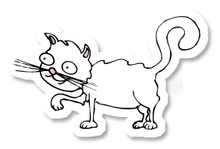
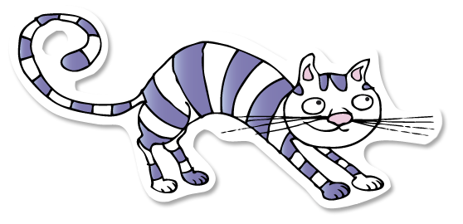
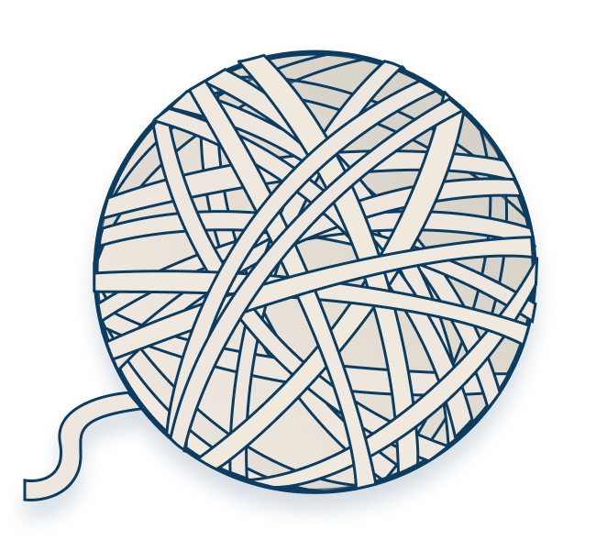

Follow Me
The cats want to play with a ball of string.
Is there enough string for each cat?
Yes, there are 3 cats and 3 balls so they would get one each.
Answers
Notes:
Concrete resources – Counters in two colours to represent the cats and string
Key Questions – How many cats are there? How many balls of string are there? Is there enough balls of string? How do you know?
Misconceptions/ Common Errors – Pupils may not identify that the groups are not even
Further Practice – Give pupils cards and cubes, ask them to match up leaving extra cubes to one side
Extension – Draw a image to show equal groups for this question

Slide 9
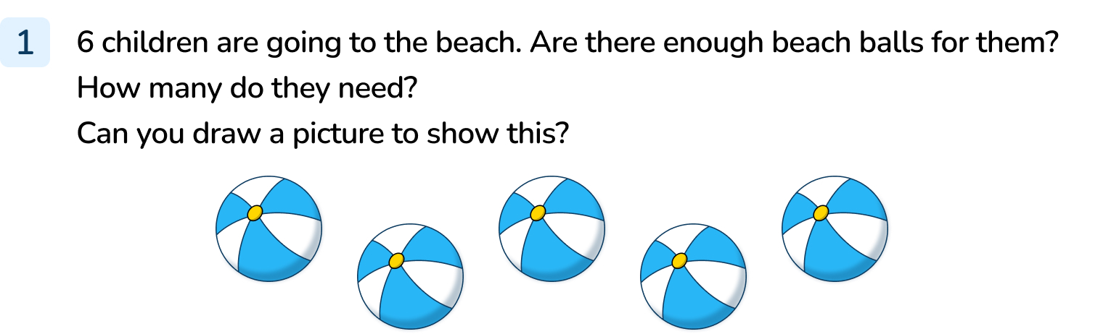
Your Turn
Notes:
There are only 5 balls.
There would not be enough beach balls for each person.
6 balls would be needed for each person to have a ball.
6 balls (and 6 people if desired) should be drawn.

Slide 10
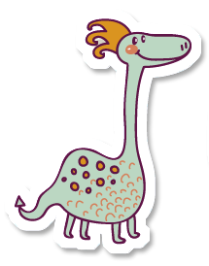
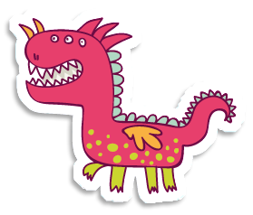


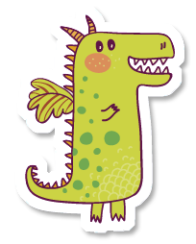
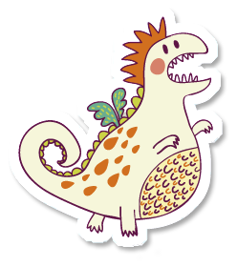
Follow Me
Which group matches the number of bones on the plate?
The dragons match the number of bones. There are 4 dragons and 4 bones.
Answers
Notes:
Concrete resources – Counters in different colours to represent the groups.
Key Questions – How many animals are in each group? How many bones are on the plate?
Misconceptions/ Common Errors – Inaccurate counting of the groups.
Extension – Add another group.

Slide 11
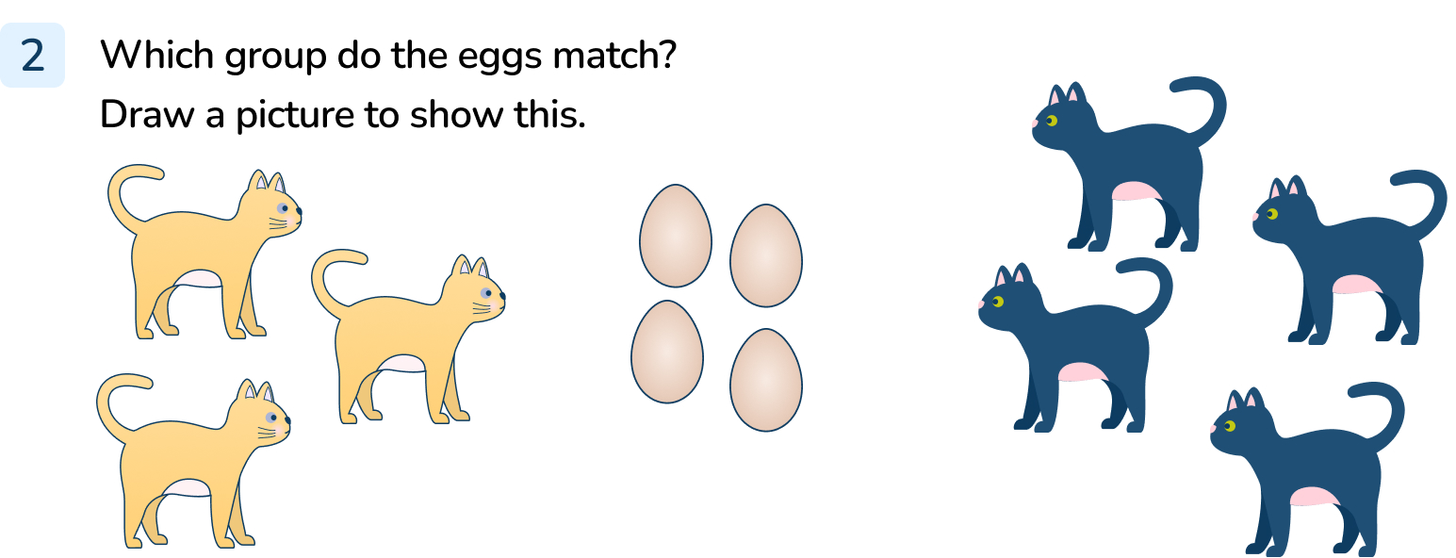
Your Turn
Notes:
The black cats match the eggs. There are 4 eggs and 4 black cats.

Slide 12

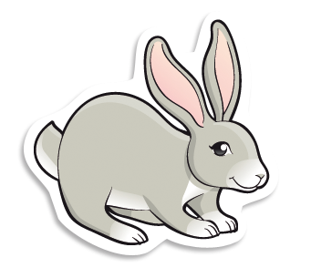

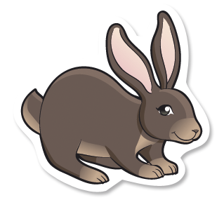
Follow Me
Each rabbit wants an apple.
Are there enough apples?
Add apples until there are enough for each rabbit.
There are not enough apples. 5 more apples are needed.
Answers
Notes:
Concrete resources – Counters in two colours to represent apples and rabbits
Key Questions – How many apples are there? How many rabbits are there? Are there enough apples? How many rabbits wouldn’t get an apple?
Misconceptions/ Common Errors – Pupils knowing there are not enough apples but not knowing how many more apples are needed.

Slide 13
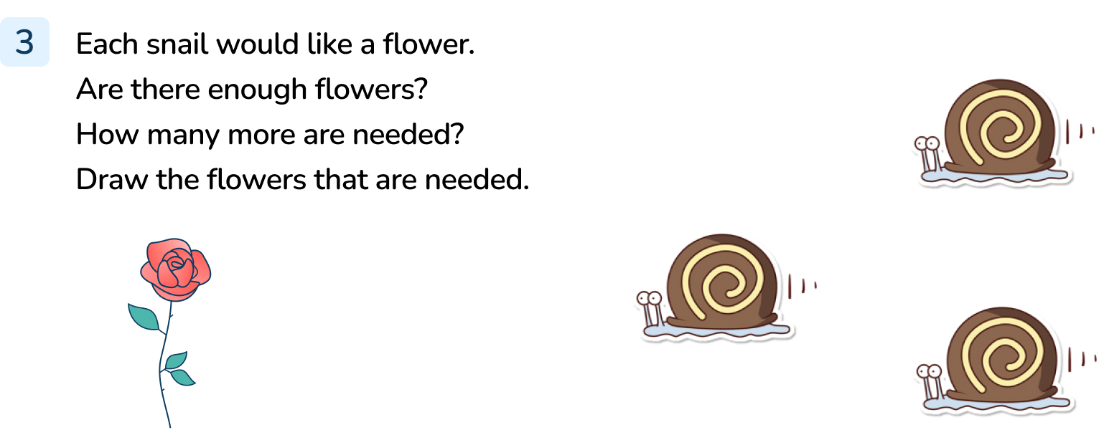
Your Turn
Notes:
There are not enough flowers. 2 more flowers are needed to match the snails.

Slide 14



Let’s Reflect
True or false?
Each Mathling can have 1 cup.
True. There are 3 Mathlings and 3 cups.
Answers
Notes:
Concrete resources – counters in 2 colours to represent the Mathlings and the cups
Key Questions – Can you draw a line from one cup to one Mathling? Are there enough cups? Are there any cups or Mathlings left?
Misconceptions/ Common Errors – Pupils joining two Mathlings to a cup or visa versa.

Slide 15
The following slides are based on:
Comparing quantities of identical objects

Slide 16

Which group has more dice?
Answers
Notes:
How and when to use these slides – Some pupils may struggle when comparing objects that are different. If they do, use these slides to ensure they understand one-to-one correspondence with identical objects.
Concrete resources – Dice
Key Questions – How many dice are in each group? Can you draw a line to match one to one? Which group has more? How do you know?

Slide 17

Which group has more balls?
Answers
Notes:
Concrete resources – Balls or counters to represent the balls
Key Questions – How many balls are in each group? Can you draw lines to match the balls in each group? Which group has more?

