Slide 1
Year 5
Place Value
To know how to read, write and represent numbers to 10,000

Slide 2
Summary
Key Vocabulary and Sentence Stems
Diagnostic Question
Learning Objective
Starter – Representations within 10,000
Let’s Learn
Follow Me – Represent numbers using expanded method
Your Turn (1) – Represent numbers using expanded method
Follow Me – Adding 10, 100, 1,000
Your Turn (2) – Adding 10, 100, 1,000
Follow Me – What is my number?
Your Turn (3) – What is my number?
Let’s Reflect
Support Slides – Based on 10s, 100s and 1,000s

Slide 3
Key Vocabulary
ten | hundred
thousand | ten thousand
place value column | representation
Sentence Stems
There are ten one thousands in ten thousand.
There are one hundred hundreds in ten thousand.

Slide 4
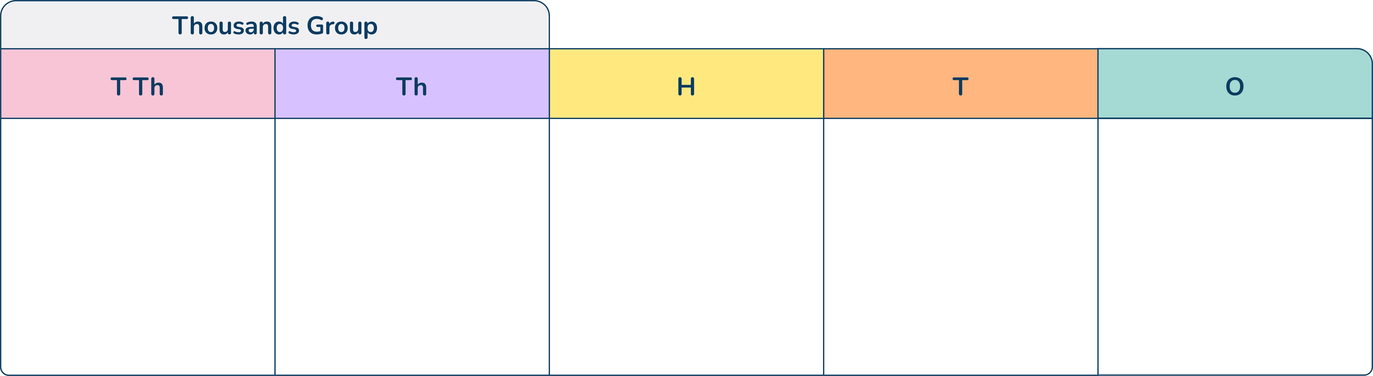

Which number is represented in the place value grid?
15,304
1,534
153.4
16,304
Notes:
Assessment point for the lesson – ask the pupils to vote for the answer they think is correct.
A – Correct answer
B – Pupils have not understood the need for the use of a placeholder 0 in the tens column.
C – Pupils have used a decimal point instead of a placeholder 0 in the tens column - they have, however, understood the need for something to be there.
D – Pupils have miscounted the number of place value counters in the Th column.

Slide 5
To read, write and represent numbers to 10,000

Slide 6
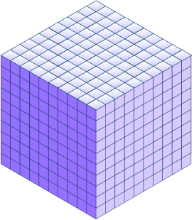



Starter
Match the numbers to their representation.
303
3,030
3,300
Answers
Notes:
Concrete resources – Place value counters, base 10, place value grids - laminated - with counters
Key Questions – Which one could we match more easily first? (Only one of them is in the hundreds) Why is the 0 important?
Extension – Increase one of the place value columns - what would that do to the numerical representation?

Slide 7
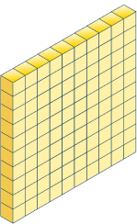

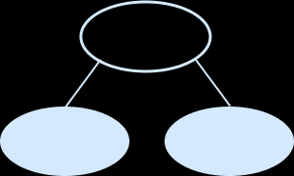
Let’s Learn
Which of these diagrams is the odd one out?
Explain your reasoning.
6,000
500
The base 10 equipment is the odd one out as it represents 650 whereas the others represent 6,500.
Answers
Notes:
Concrete resources – Base 10 equipment, place value counters, place value chart
Key Questions – What do each of these representations show? How do you know? Which ones represent the same number? One of them doesn’t - why not?
Misconceptions/ Common Errors – Pupils may not include the place holder 0s in the correct place - if at all, pupils may place digits in the incorrect place value column
Further Practice – Alter the numbers represented or the way in which they are represented
Extension – Ask pupils how the odd one out would need to be altered to make it part of the set

Slide 8
Follow Me
Complete the following number sentences:
6,749 = 6,000 + 700 + _____ + 9
8,000 + _____ + 4 = 8,094
How could we partition this number: 3,847
Which of these is not a way to partition 9403?
9,000 + 40 + 3 9,000 + 400 + 3
40
90
Answers may vary but all must equal 3,847
9,000 + 40 + 3
Answers
Notes:
Concrete resources – Place value equipment such as base 10, place value mats, place value counters
Key Questions – How have these numbers been partitioned? What is the missing number in each addition? How do we know that?
Misconceptions/ Common Errors – In the second question, pupils may find the fact that there are no hundreds confusing which could impact how they represent the 90
Further Practice – Give pupils further numbers to partition with particularly where there is a place holder 0 in the number

Slide 9
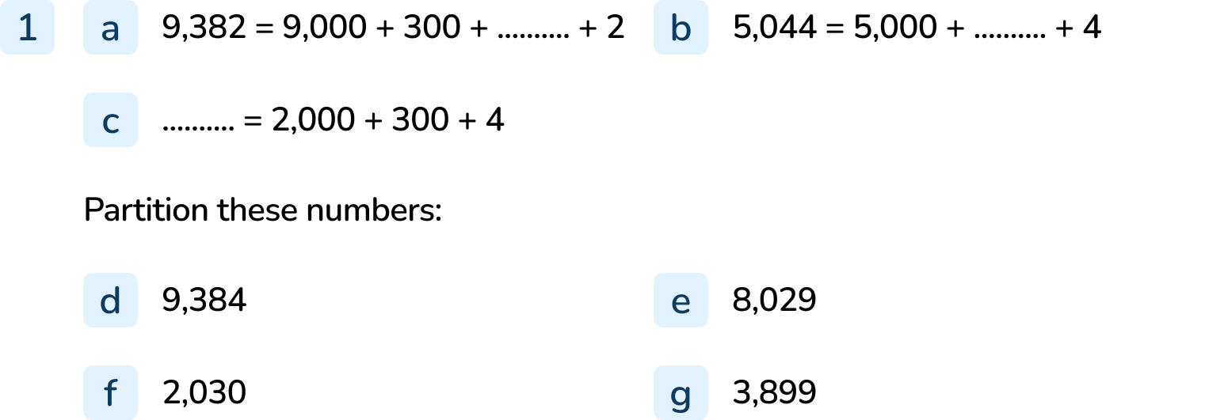
Your Turn
Notes:
80
40
2,304
9,000 + 300 + 80 + 4
8,000 + 20 + 9
2,000 + 30
3,000 + 800 + 90 + 9

Slide 10
Follow Me
Complete the table.
 | Add 10 | Add 100 | Add 1,000
4,843
7,999
 |  | 2,250
 | 4,853 | 4,943 | 5,843
 | 8,009 | 8,099 | 8,999
2,150 | 2,160 |  | 3,150
Answers
Notes:
Concrete resources – Place value equipment, place value counters, place value chart
Key Questions – Which place value column will change? How will it change? What will happen to the other digits? What happens when we add 10, 100 or 1000 to 90, 900 or 9000? How will we use the inverse to find the original number?
Misconceptions/ Common Errors – The key here is how columns containing 9 will be changed - the pupils need to understand that this is where regrouping/exchanging will occur. If pupils are not confident with this, the use of straw bundles or place value charts will be useful.
Further Practice – Change the numbers on the right hand side.

Slide 11
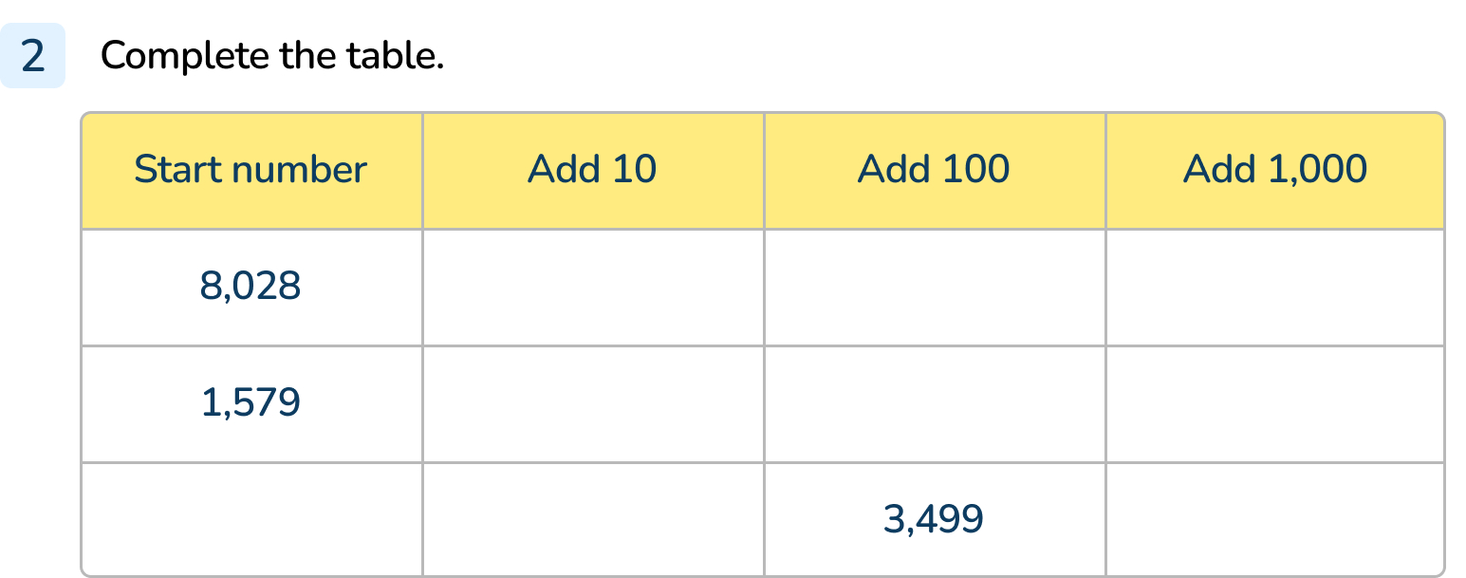
Your Turn
Notes:
8,028 → 8,038 → 8,128 → 9,028
1,579 → 1,589 → 1,679 → 2,579
3,399 → 3,409 → 3,499 → 4,399

Slide 12
Follow Me
Josh is thinking of a number. It is a four digit number.
The ones digit is half the hundreds digit.
There are eight hundreds in the number.
The number in the tens column is one less than the number in the ones column.
The thousands digit is the sum of the tens and ones digit.
7,834
Answers
Notes:
Concrete resources – Place value grids and counters
Key Questions – What do you notice about the clues? What resource could you use to help you?

Slide 13
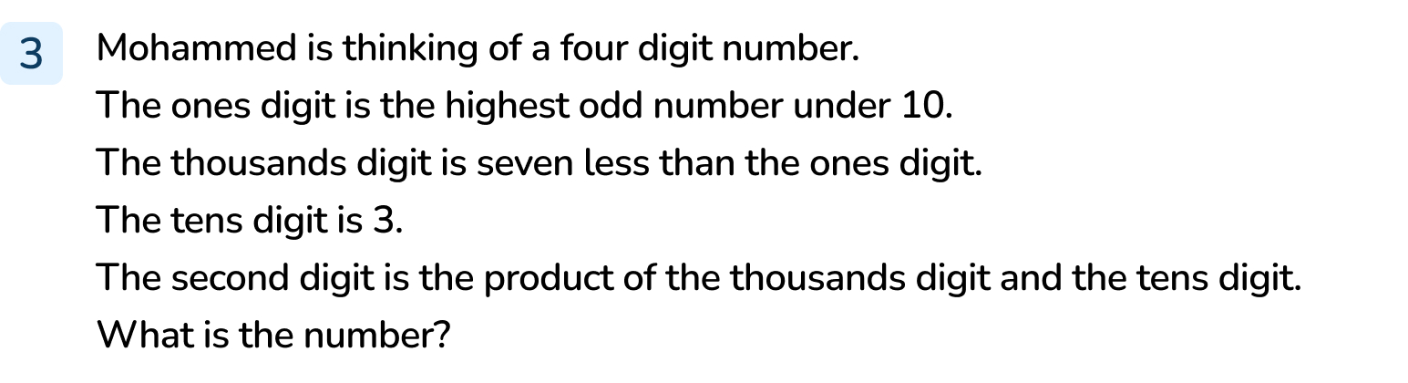
Your Turn
Notes:
2,639

Slide 14
Let’s Reflect
Use the place value equipment on your table to represent the following number:
Show what happens when you add 10 to it and write it numerically.
What happens when you add 100 to it?
Show using the concrete resources and explain what is happening and why.
8,959
When you add 10 it equals 8,969
When you add 100 to it it equals 9,059 because 9 hundreds and 1 hundred make 1 thousand.
Answers
Notes:
Pupils will choose the equipment and should use it to show 8,959. Pupils may show regrouping using their place value equipment when adding 100.
Concrete resources – Pupils will need place value equipment (give a varied selection to allow pupils to select independently), place value grids
Key Questions – How does your equipment represent the number? How do you know that you are correct? What happens when you add 10, 100 and 1,000? What is happening to the place value columns? What happens when the place value column is 9?

Slide 15
The following slides are based on:
10s, 100s and 1,000s

Slide 16
How many 1,000s are in this number?
How many 100s, 10s and 1s are in this number?
Can you represent this number on a place value chart using place value counters?
How would this be written numerically?
3
Five 100s, three 10s, seven 1s
Represent using a place value chart
3,537
Answers
Notes:
How and when to use these slides – These slides should be used to revise place value to 9,999. They could be used as a pre-learning task with lower ability pupils before the main lesson or could be used to revise gaps that have been identified in the main teaching.
Concrete resources –Blank place value grid, place value counters, base ten equipment
Key Questions – How many 1000s are there? How many 10s, 100s, 1s? How would that be written in digits. What does the 3 stand for? What is the value of the 5? What is the value of the 7?
Misconceptions/ Common Errors – Pupils may not recognise the place value of each digit, they may not understand that 3 thousands is larger than 5 hundreds when 5 is larger than 3
Further Practice – Pupils may need to practise this with other numbers, pupils could be given a number numerically and asked to represent it using place value equipment

Slide 17
What is the value of the underlined digit in each number?
Use the clues to find the missing 4-digit number:
The thousands digit is the product of the hundreds digit and the ones digit.
The tens digit is the largest single digit number.
The ones digit is 4.
The hundreds digit and the ones digit total 6.
5,403
8,948
3,562
4,038
3
900
3,000
30
8,294
Answers
Notes:
How and when to use these slides – These slides should be used to revise place value to 9,999. They could be used as a pre-learning task with lower ability pupils before the main lesson or could be used to revise gaps that have been identified in the main teaching.
Concrete resources – Pupils may use place value equipment or place value charts
Key Questions – What does this digit represent? What is the place value of…?
Misconceptions/ Common Errors – Pupils may not understand that digits represent a value or may mistake the order of the place value columns
Further Practice – Order the numbers - how do we use the place value to determine the order?

