Slide 1

Where a love of learning grows
Growing in knowledge
Growing in faith
Growing in God’s love
Philippians 4:13
“I can do all things through Christ who strengthens me”

Slide 2

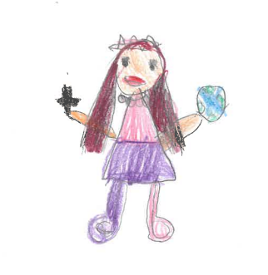
Courage
1 Corinthians 16: 13
Stand firm in the faith; be courageous; be strong

Slide 3
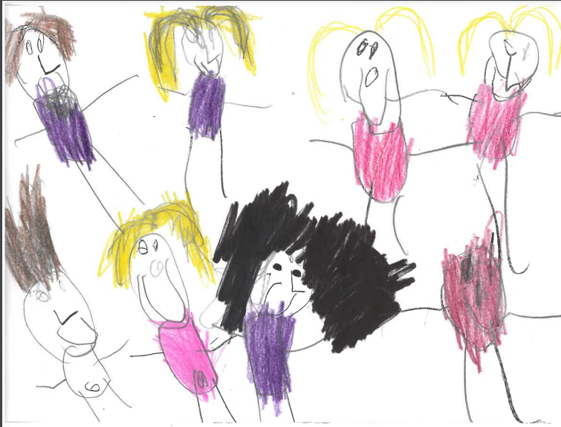
Friendship
Ecclesiastes 4: 9 – 12
Two people are better off than one, for they can help each other succeed. If one person falls, the other can reach out and help

Slide 4

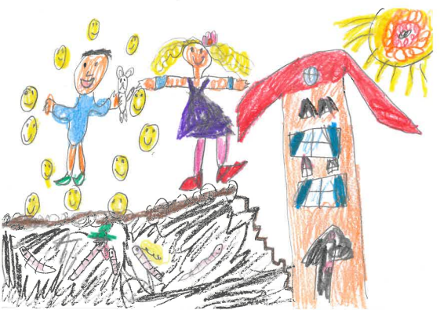
Generosity
Timothy 6: 19
Be rich in good deeds, and to be generous and willing to share

Slide 5
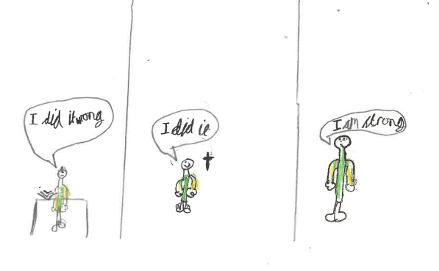
Perseverance
Romans 5: 4
Endurance produces character, and character produces hope

Slide 6
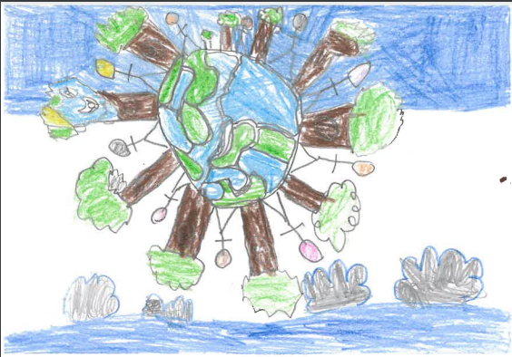
Respect
Mark 12:31
Love your neighbour as yourself

Slide 7
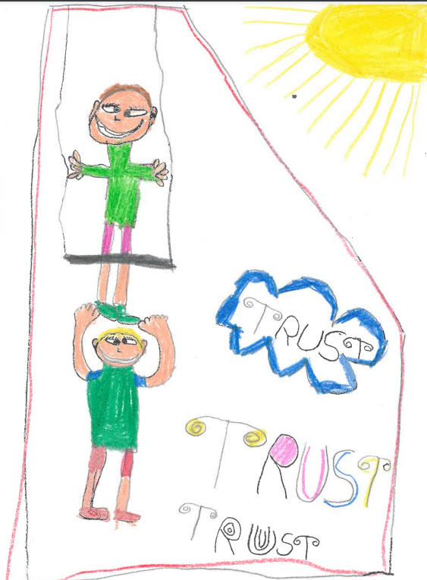
Trust
Psalm 56: 3
In God, whose word I praise, in God I trust; I shall not be afraid.

